Slide 1
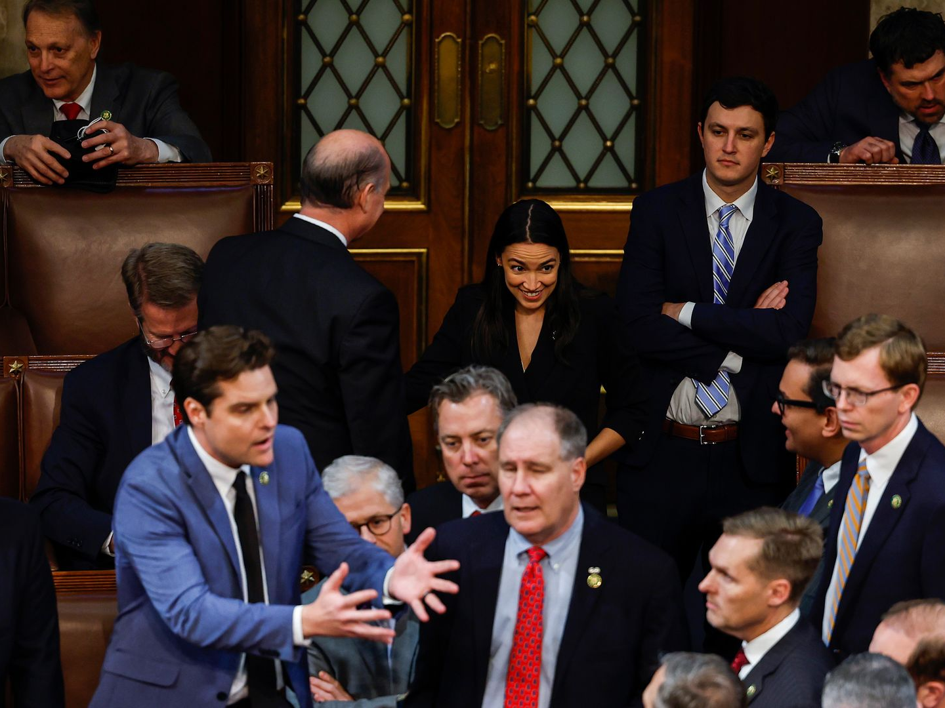
Political Science 40: Introduction to American Politics
Prof. Chris Tausanovitch
@ctausanovitch
Lecture 1: What’s at Stake?

Slide 2
Enrollment
This class is full!
I don’t give out PTE numbers.
If your enrollment is contingent on switching discussion sections, you must find another student to switch with.

Slide 3
Plan for today
why you should take this class
how this class works
the policy content of American politics
Notes:
What’s at stake in this class as well as what’s at stake in this government

Slide 4
About me
Tau-sahn-oh-vitch
I study policy representation in American politics.
What connection is there between the choices representatives make and the policy views of their constituents?

Slide 5
About me
I’ve worked in Congress
I wrote a book about the 2020 election
I co-ran Nationscape, the largest ever academic survey of political views

Slide 6
Learning Goals
Fundamentals of American politics
How political scientists learn
Engaging critically with claims about politics
How to make an argument
But why should you learn these things?

Slide 7
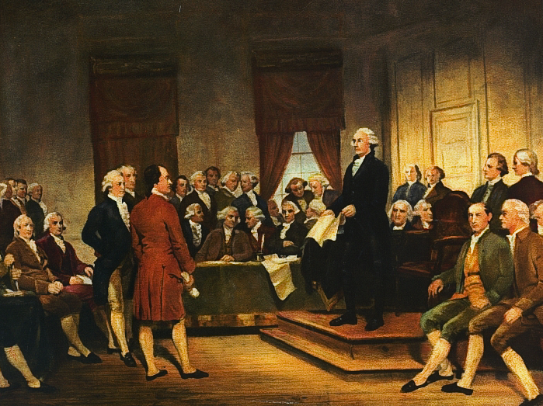
Why Study American Politics?
Notes:
It might seem awful, but understanding can grant some equanimity.
It might seem dominated by old white guys, but that is changing- don’t let us have it.
I could say a lot of cliché things about the importance of America in the world
It’s important for your own integrity!
It’s the water in which we swim. You have to be curious about it.
You are in a position to matter in American Politics.

Slide 8
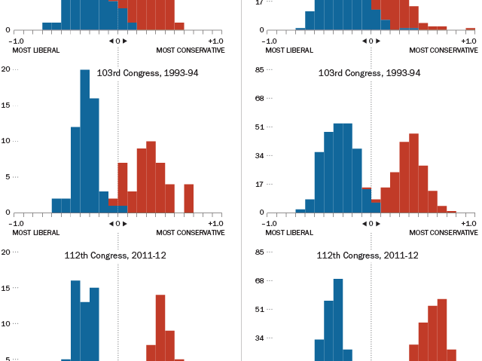
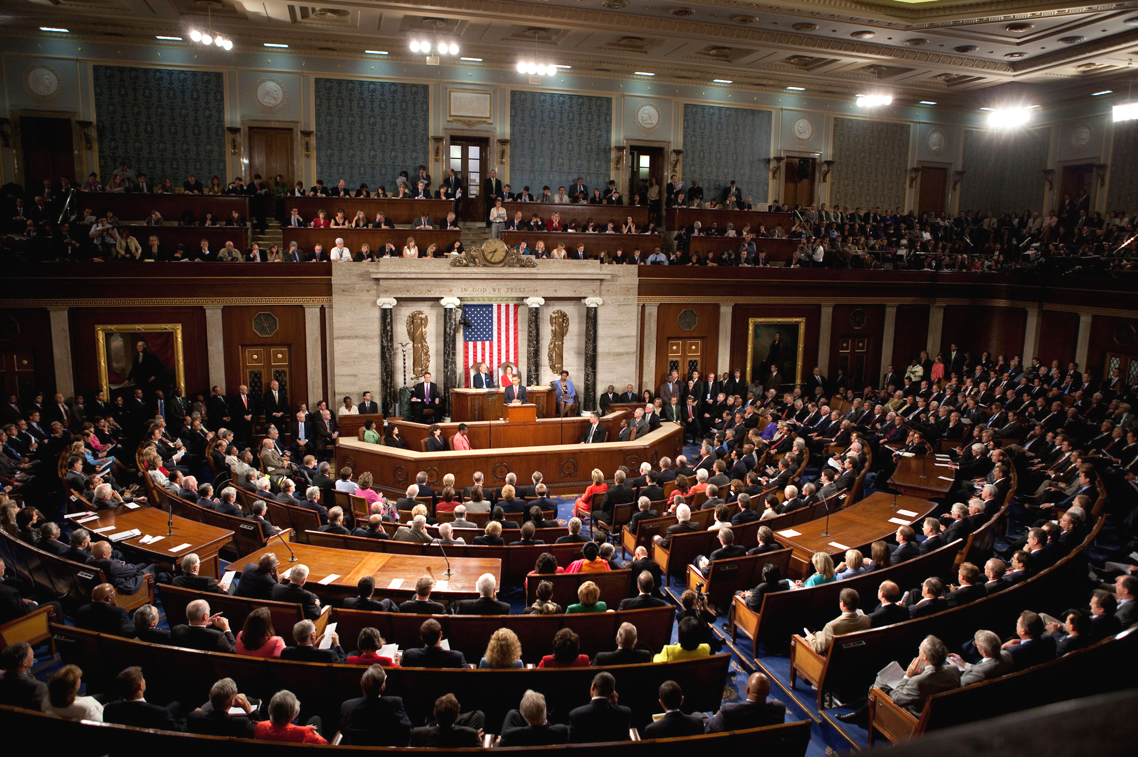
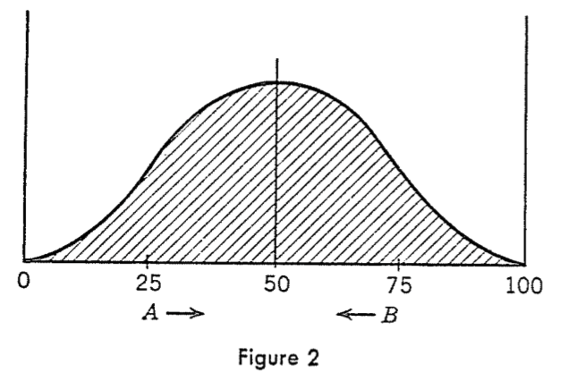
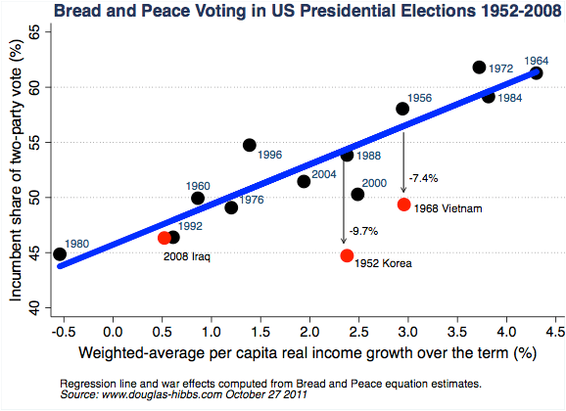
Political science
Notes:
Theory and evidence
This is going to help you make sense of the world, and not just the political world

Slide 9
Some claims about politics*
*That at least some top political scientists believe!
Gerrymandering doesn’t increase polarization
Money doesn’t really matter that much
Campaigns don’t matter very much
Divided government doesn’t affect legislative productivity
Legislators do a good job of representing the views of their citizens
Large bureaucracies are vital for effective government

Slide 10
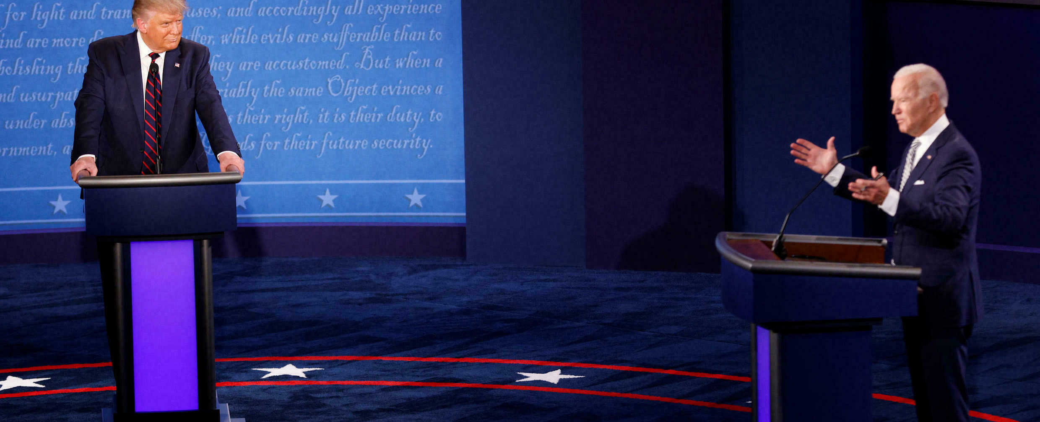
How to make an argument
Fundamental to communicating and to thinking
The job market wants this
The key is simple but hard: consider that you might be wrong

Slide 11
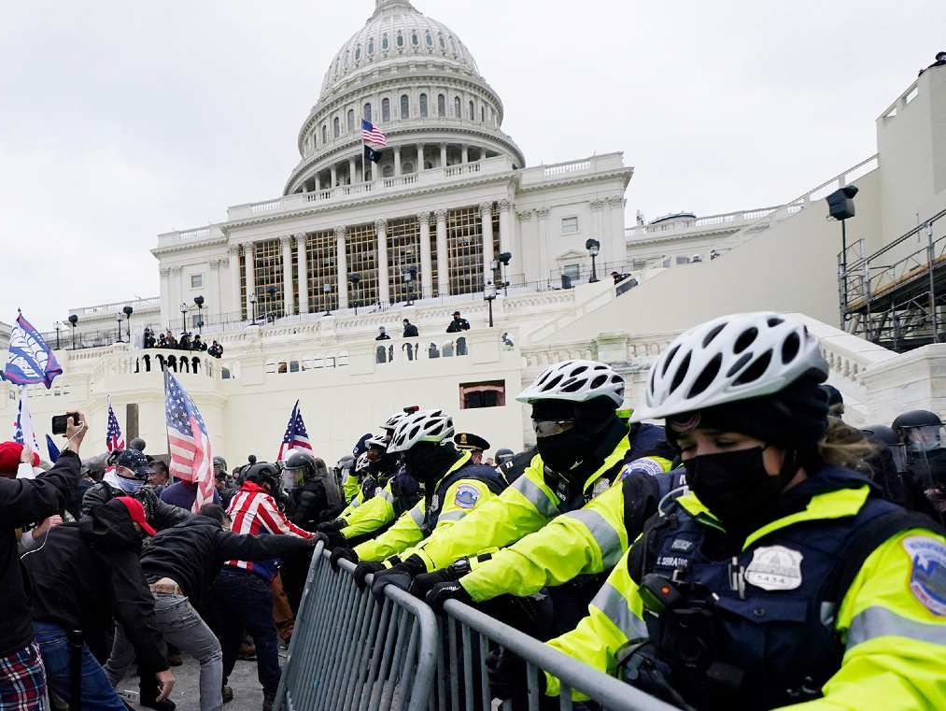
Lastly, maybe democracy is depending on you?

Slide 12
On to the syllabus

Slide 13
Required materials
Logic of American Politics 11th edition
Inclusive Access
UCLA Store Course Materials tab
All materials available on the course website
https://bruinlearn.ucla.edu/courses/179900

Slide 14
Requirements
Participation – 10%
Take-Home Essay – 20%
Midterm – 25%
All material up to the midterm
Final – 45%
Cumulative for the whole class

Slide 15
Learning-related disabilities
It is your responsibility to tell your TA and CAE by the end of next week if you require special accommodations
This will give us the time to plan ahead
If you have, or suspect you have, a learning disability, also contact the UCLA Center for Accessible Education

Slide 16
TA sections
Sections have their own reading
Grade will depend on active participation
You may miss one and only one section, after that you lose a half letter grade (5 points)
No section this week

Slide 17
Final Exam
March 18th, 11:30am to 2:30pm
In-person attendance at this time is mandatory, and travel will not be accepted as an excuse not to attend.

Slide 18
Stuff I shouldn’t have to say
Do your own work.
If you have any doubt about what that means, ask your TA. Cite sources when you are using material that is not yours, and make it clear what is yours and what is not.
Also, consult university policy: www.deanofstudents.ucla.edu.

Slide 19
Use of AI
We are in the era of advanced AI. AI can write complete essays for you, etc.
You can and should use AI to generate ideas, answer questions etc. However all of your writing must be your own.
As of this movement, most text generating AIs still “hallucinate,” and rely heavily on cliché and banal answers.

Slide 20
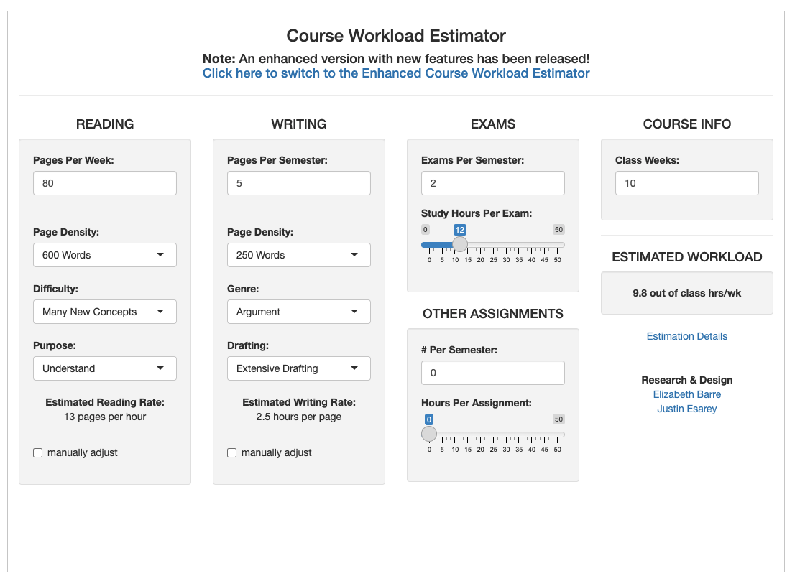
Time management

Slide 21
Getting in touch with me
Office hours: Thursdays 2-4, Bunche 3383
Email: ctausanovitch@ucla.edu.
Email from your @ucla.edu
Keep it to the point
My replies are often brief

Slide 22
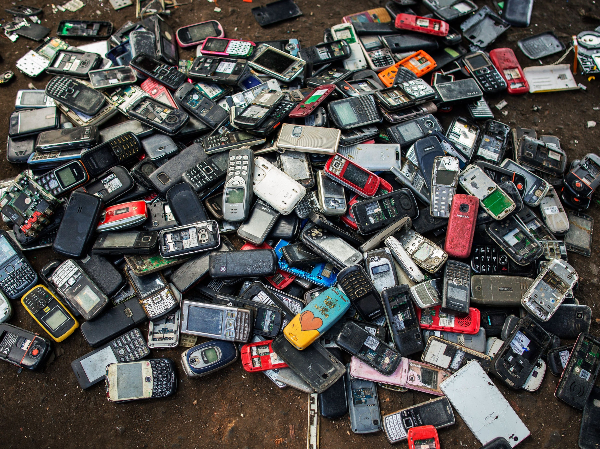
And as always
Please silence your cell phones and put them away.
Notes:
If you are not enrolled, you should know that the class is full and there is no waitlist. If someone drops the class, you are welcome to join

Slide 23
Questions?

Slide 24
Week 1 Survey
I have put a survey under the “Quizzes” tab on the course website
Please complete this 8-question survey by class next Tuesday
Do not look up the answers
This survey will not count towards your grade in the class

Slide 25
On objectivity and respect in our polarized times
Notes:
We are in the midst of a recurring debate about free speech in universities.

